Slide 1
Forecasting –gold price prediction
Progress meeting-2
Shyam prasad s
Pavithra
Floyd Fernandes
Anusha
Jaya
Shalini

Slide 2
Objective
The objective of the analysis is to predict an item when sold, what is the probability that customer would file fraudulent / Genuine warranty and to understand important factors associated with them

Slide 3
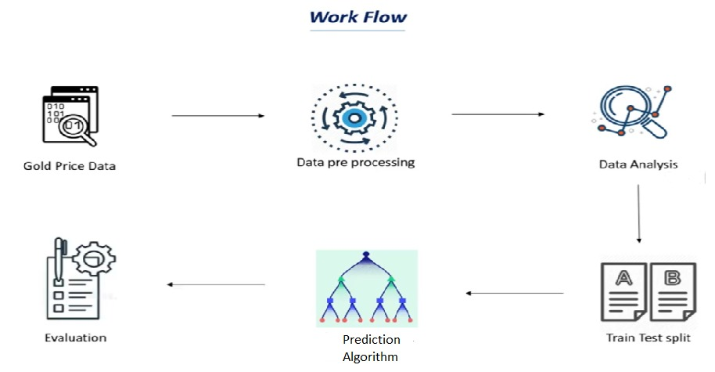
Project flow

Slide 4
Data analysis
Provided data was time series data where the gold prices were given from 1968 to 2021
Gold prices are increasing exponentially with respective to the time in the given data
The given data provides the price per ounce of gold

Slide 5
Data analysis
The given data consists do have missing values in the gold price column
By interpolating method the average has been calculated and filled in the missing values
Further data set has been taken forward to Exploratory Data Analysis

Slide 6
Data analysis
The data set is further subjected to the visualisation
By using plotting library matplotlib data has been analysed

Slide 7
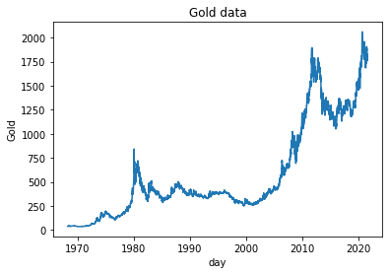
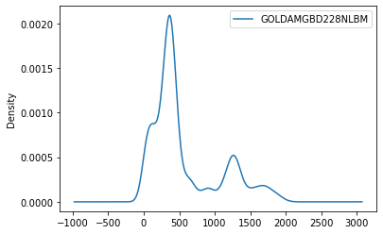
Visualizations

Slide 8
Exploratory data analysis
The data has been treated with all the null values
The missing dates has been restored by datetime program
The data set is further subjected to the tests testing for stationarity or nan-stationarity

Slide 9
Dicky fuller test analysis
Results of Dickey-Fuller Test: p-value = 0.9983. The series is likely non-stationary. Test Statistic 1.772208 p-value 0.998292 #Lags Used 19.000000 Number of Observations Used 15556.000000 Critical Value (1%) -3.430770 Critical Value (5%) -2.861726 Critical Value (10%) -2.566869

Slide 10
eda
Data is fount to be non-stationarity in nature
The models with data set can be tested are with
Linear Regression
ARIMA
Arma

Slide 11
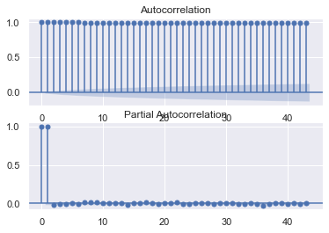
Acf and pacf plots

Slide 12
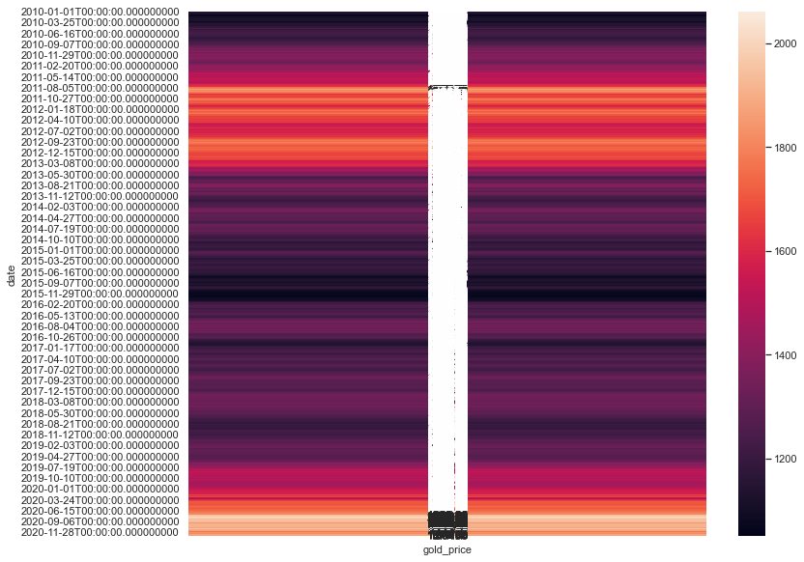
Heat map

Slide 13
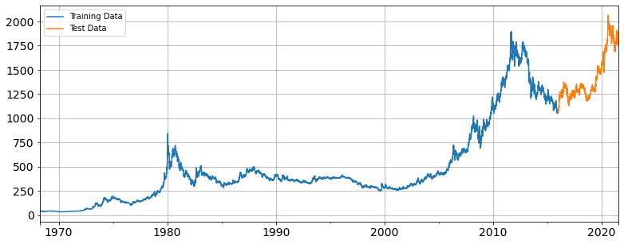
Model building
The given data set subjected to linear regression model
After testing and training obtained results are

Slide 14
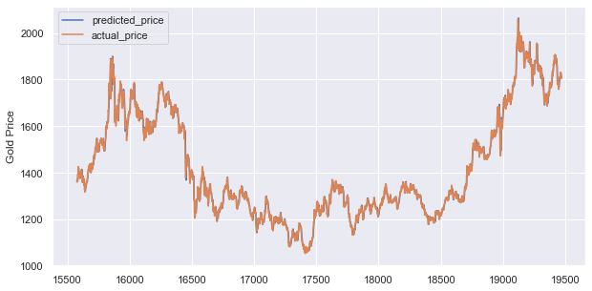
Prediction vs actual value

Slide 15
thank you

